Slide 1
HOUSE PRICE PREDICTION
Team Name/No:
Hardik Singh 2210990358
Harsh Oberoi 2210990381
Harshdeep Singh 2210990384

Slide 2
Index
Objective
Introduction
Methodology, Approach & Techniques
Algorithm
Flow Chart
Conclusion

Slide 3
Objective
The objective of this project appears to be the development of a machine learning model for predicting housing prices. The project likely aims to leverage historical housing data to train a regression model capable of accurately estimating the prices of houses based on various features such as the number of rooms, location, age of the property, etc.
Data Collection and Cleaning: Gather data on house attributes and preprocess it to handle missing values and outliers.
Model Training: Train a machine learning model to predict house prices based on the input attributes.
Model Evaluation: Evaluate the accuracy of the trained model using appropriate metrics like mean squared error.
Model Deployment: Save the trained model for future use and test its performance on unseen data to ensure reliability before deployment.

Slide 4
Introduction
Predicting House Prices
In this project, we aim to develop a machine learning model to predict house prices based on various attributes such as location, size, number of rooms, and other relevant factors. The ability to accurately predict house prices is crucial for real estate agents, homeowners, and buyers alike, as it helps in making informed decisions regarding buying, selling, or investing in properties.
By leveraging machine learning techniques, we seek to create a model that can provide reliable price estimates, thereby assisting stakeholders in the real estate market to make better-informed decisions. This project involves the collection, preprocessing, and analysis of housing data, followed by the training and evaluation of predictive models. Ultimately, our goal is to deploy a robust model that can accurately predict house prices, contributing to more efficient and informed decision-making in the real estate industry.

Slide 5
Methodology, Approach & Techniques
The Methodology of this project encompasses comprehensive data preprocessing, including handling missing values and scaling features. The Approach involves applying various regression algorithms, such as Linear Regression, Decision Tree Regression, and Random Forest Regression, to train predictive models. Techniques like feature scaling, pipeline creation for seamless data processing, and cross-validation for model evaluation are employed. Additionally, hyperparameter tuning is utilized to optimize model performance. The combined use of these approaches and techniques ensures the development of accurate and reliable housing price prediction models.

Slide 6
Algorithm
The main algorithm employed in this project is the Random Forest Regression algorithm. It is a powerful ensemble learning technique that constructs multiple decision trees during training and outputs the average prediction of the individual trees. This algorithm is chosen for its ability to handle complex datasets, capture non-linear relationships between features and target variables, and mitigate overfitting. By leveraging the randomness in feature selection and bootstrapping, Random Forest Regression yields robust and accurate predictions, making it suitable for housing price prediction tasks.

Slide 7
Algorithm Used
Algorithms Used for Training ,Testing and Predictions:
Logistic Regression
Decision Tree Classifier
RandomForestClassifier
Gradient Boosting Classifier

Slide 8
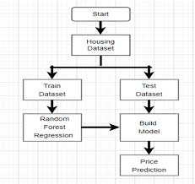
Flowchart

Slide 9
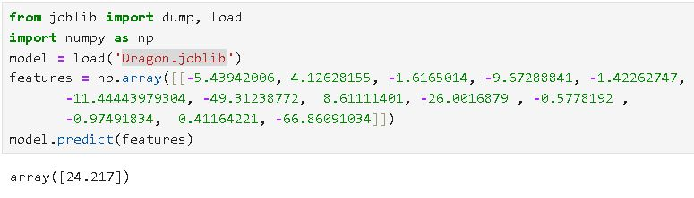
Result
22CS016

Slide 10
Conclusion
The house price prediction using machine learning project successfully demonstrated the effectiveness of various regression algorithms in predicting house prices based on relevant features. By employing techniques such as data preprocessing, feature scaling, model selection, and evaluation, we were able to develop a reliable predictive model. The chosen Random Forest Regressor algorithm showed promising results in predicting house prices with a reasonably low root mean squared error (RMSE). Additionally, cross-validation provided a robust evaluation of the model's performance, ensuring its generalizability. Overall, this project highlights the potential of machine learning techniques in real estate applications, offering valuable insights for both buyers and sellers in the housing market.

Slide 11
The End
Thank you

